Slide 1

Analyze historical weather data
Students :
mohmmad Shabaro
Odai aldabbas

Slide 2
Data Loading and Cleaning
Input :
import pandas as pd
import matplotlib.pyplot as plt
df = pd.read_csv("weatherHistory.csv")
df['Formatted Date'] = pd.to_datetime(df['Formatted Date'], utc=True)
df['Formatted Date'] = df['Formatted Date'].dt.tz_localize(None)
df['Date'] = pd.to_datetime(df['Formatted Date'].dt.date)
df['Hour'] = df['Formatted Date'].dt.hour
df = df.dropna(subset=['Precip Type'])
df.set_index('Date', inplace=True)

Slide 3
Basic Statistics
Input :
print("--- Temperature Statistics ---")
print(df['Temperature (C)'].describe())
print("\n--- Wind Speed Statistics ---")
print(df['Wind Speed (km/h)'].describe())
print("\n--- Humidity Statistics ---")
print(df['Humidity'].describe())
print("\n--- Pressure (millibars) Statistics ---")
print(df['Pressure (millibars)'].describe())

Slide 4
Basic Statistics
print("\n--- Wind Bearing (degrees) Statistics ---")
print(df['Wind Bearing (degrees)'].describe())
print("\n--- Visibility (km) Statistics ---")
print(df['Visibility (km)'].describe())
print("\n--- Precipitation Types ---")
print(df['Precip Type'].value_counts())
print("\n--- Weather Summaries ---")
print(df['Summary'].value_counts())
print("\n--- daily weather summaries ---")
print(df['Daily Summary'].value_counts())

Slide 5
Basic Statistics
Output :
--- Temperature Statistics ---
count 95936.000000
mean 11.940976
std 9.570671
min -21.822222
25% 4.604167
50% 12.033333
75% 18.844444
max 39.905556
Name: Temperature (C), dtype: float64

Slide 6
Basic Statistics
--- Wind Speed Statistics ---
count 95936.000000
mean 10.804936
std 6.920727
min 0.000000
25% 5.796000
50% 9.933700
75% 14.135800
max 63.852600
Name: Wind Speed (km/h), dtype: float64

Slide 7
Basic Statistics
--- Humidity Statistics ---
count 95936.000000
mean 0.734841
std 0.195724
min 0.000000
25% 0.600000
50% 0.780000
75% 0.890000
max 1.000000
Name: Humidity, dtype: float64

Slide 8
Basic Statistics
--- Pressure (millibars) Statistics ---
count 95936.000000
mean 1003.150038
std 117.276976
min 0.000000
25% 1011.890000
50% 1016.420000
75% 1021.050000
max 1046.380000
Name: Pressure (millibars), dtype: float64

Slide 9
Basic Statistics
--- Wind Bearing (degrees) Statistics ---
count 95936.000000
mean 187.518773
std 107.385351
min 0.000000
25% 116.000000
50% 180.000000
75% 290.000000
max 359.000000
Name: Wind Bearing (degrees), dtype: float64

Slide 10
Basic Statistics
--- Visibility (km) Statistics ---
count 95936.000000
mean 10.362402
std 4.173780
min 0.000000
25% 8.372000
50% 10.046400
75% 14.812000
max 16.100000
Name: Visibility (km), dtype: float64

Slide 11
Basic Statistics
--- Precipitation Types ---
Precip Type
rain 85224
snow 10712
Name: count, dtype: int64

Slide 12
Basic Statistics
--- Weather Summaries ---
Summary
Partly Cloudy 31635
Mostly Cloudy 27914
Overcast 16516
Clear 10763
Foggy 7117
Breezy and Overcast 528
Breezy and Mostly Cloudy 516
Breezy and Partly Cloudy 386
Dry and Partly Cloudy 86
Windy and Partly Cloudy 67
Light Rain 63
Breezy 54
Windy and Overcast 45

Slide 13
Basic Statistics
Humid and Mostly Cloudy 40
Drizzle 39
Breezy and Foggy 35
Windy and Mostly Cloudy 35
Dry 34
Humid and Partly Cloudy 17
Dry and Mostly Cloudy 14
Rain 10
Windy 8
Humid and Overcast 7
Windy and Foggy 4
Dangerously Windy and Partly Cloudy 1
Windy and Dry 1
Breezy and Dry 1
Name: count, dtype: int64

Slide 14
Basic Statistics
--- daily weather summaries ---
Daily Summary
Mostly cloudy throughout the day. 20020
Partly cloudy throughout the day. 9930
Partly cloudy until night. 6169
Partly cloudy starting in the morning. 5177
Foggy in the morning. 4201
Rain until afternoon. 17
Rain until morning. 12
Light rain in the morning. 11
Drizzle starting in the evening. 9
Light rain overnight. 3
Name: count, Length: 214, dtype: int64

Slide 15
Univariate Analysis
Input :
plt.figure(figsize=(18, 4))
plt.subplot(1, 3, 1)
plt.hist(df['Temperature (C)'], bins=40, color='orange', edgecolor='black')
plt.title('Temperature Distribution')
plt.subplot(1, 3, 2)
plt.hist(df['Humidity'], bins=40, color='lightblue', edgecolor='black')
plt.title('Humidity Distribution')
plt.subplot(1, 3, 3)
plt.hist(df['Wind Speed (km/h)'], bins=40, color='green', edgecolor='black')
plt.title('Wind Speed Distribution')
plt.tight_layout()
plt.show()

Slide 16
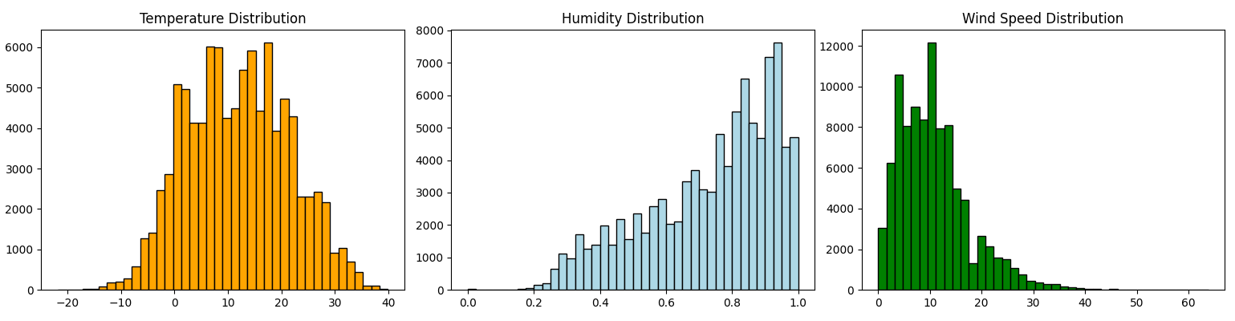
Univariate Analysis
Output :

Slide 17
Univariate Analysis
Input :
plt.figure(figsize=(10, 4))
df['Precip Type'].value_counts().plot(kind='bar', color='purple', edgecolor='black')
plt.title('Precipitation Type Frequency')
plt.ylabel('Count')
plt.xticks(rotation=0)
plt.grid(axis='y')
plt.show()
plt.figure(figsize=(10, 4))
df['Summary'].value_counts().head(10).plot(kind='bar', color='skyblue', edgecolor='black')
plt.title('Top 10 Weather Summaries')
plt.ylabel('Count')
plt.xticks(rotation=45)
plt.grid(axis='y')
plt.tight_layout()
plt.show()

Slide 18
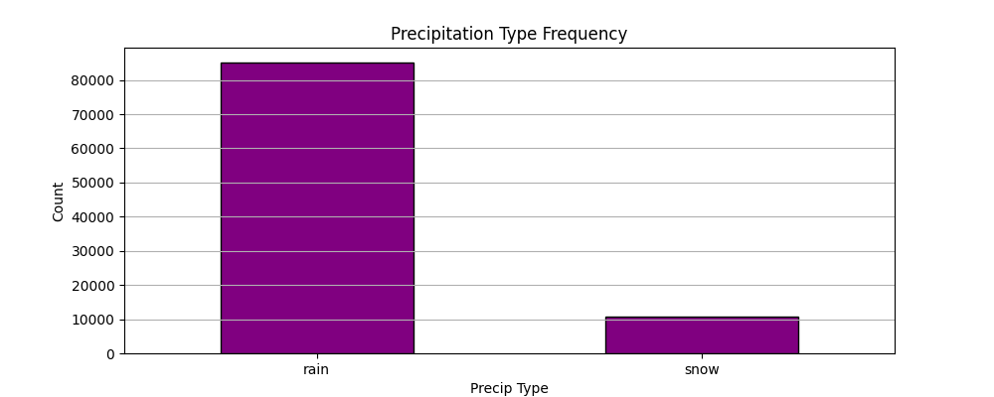
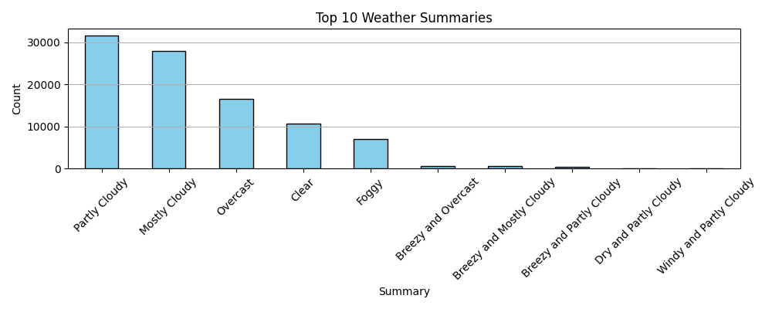
Univariate Analysis
Output :

Slide 19
Univariate Analysis
Input :
summary_counts = df['Summary'].value_counts()
selected_summaries = summary_counts.iloc[9:20]
plt.figure(figsize=(10, 4))
selected_summaries.plot(kind='bar', color='skyblue', edgecolor='black')
plt.title('Weather Summaries from 10 to 20')
plt.ylabel('Count')
plt.xticks(rotation=45)
plt.grid(axis='y')
plt.tight_layout()
plt.show()
plt.figure(figsize=(10, 4))
df['Summary'].value_counts().tail(5).plot(kind='bar', color='skyblue', edgecolor='black')
plt.title('Bottom 5 Weather Summaries')
plt.ylabel('Count')
plt.xticks(rotation=45)
plt.grid(axis='x')
plt.tight_layout()
plt.show()

Slide 20
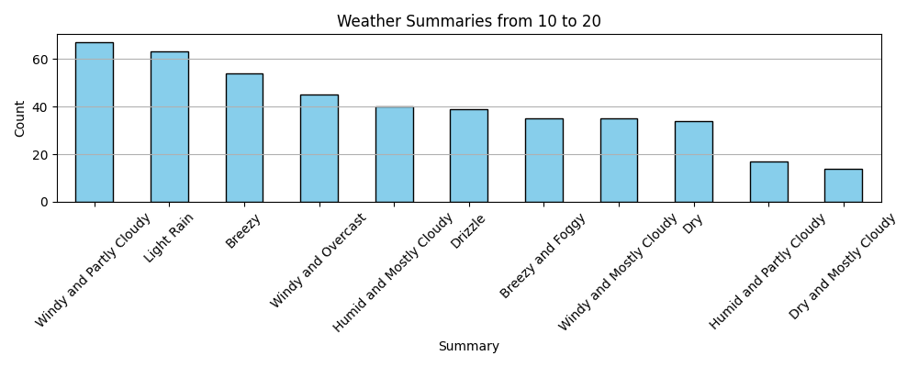
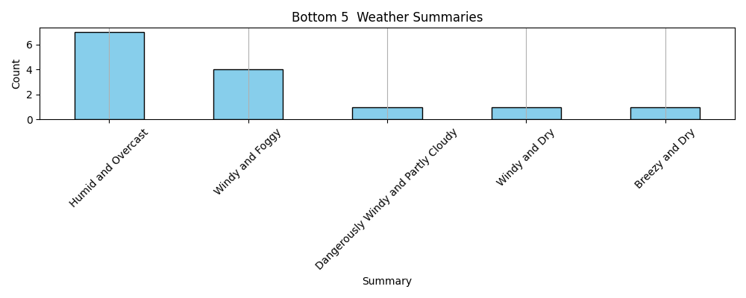
Univariate Analysis
Output :

Slide 21
Univariate Analysis
Input :
plt.figure(figsize=(10, 4))
df['Daily Summary'].value_counts().head(5).plot(kind='bar', color='sandybrown', edgecolor='black')
plt.title('Top 5 Daily Weather Summaries')
plt.ylabel('Count')
plt.xticks(rotation=45)
plt.grid(axis='y')
plt.tight_layout()
plt.show()
plt.figure(figsize=(10, 4))
df['Daily Summary'].value_counts().tail(5).plot(kind='bar', color='sandybrown', edgecolor='black')
plt.title('Bottom 5 Daily Weather Summaries')
plt.ylabel('Count')
plt.xticks(rotation=45)
plt.grid(axis='y')
plt.tight_layout()
plt.show()

Slide 22
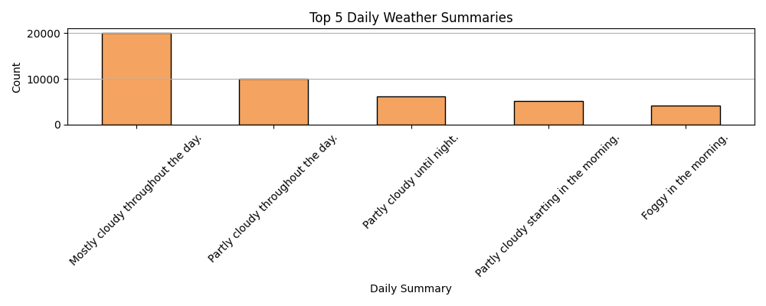
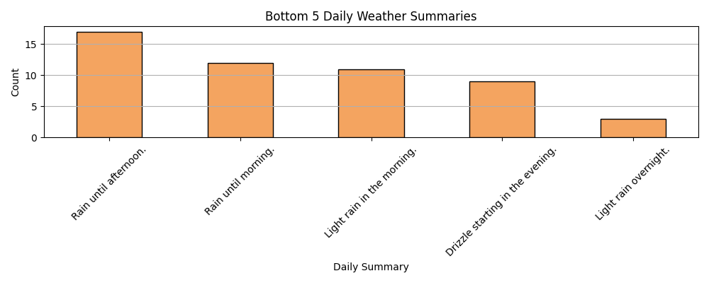
Univariate Analysis
Output :

Slide 23
Time Series Trends
Input :
daily_avg = df['Temperature (C)'].resample('D').mean()
monthly_avg = df['Temperature (C)'].resample('ME').mean()
yearly_avg = df['Temperature (C)'].resample('YE').mean()
plt.figure(figsize=(14, 4))
plt.plot(daily_avg.index, daily_avg.values, color='red')
plt.title('Daily Average Temperature')
plt.ylabel('Temperature (C)')
plt.grid(True)
plt.tight_layout()
plt.show()

Slide 24
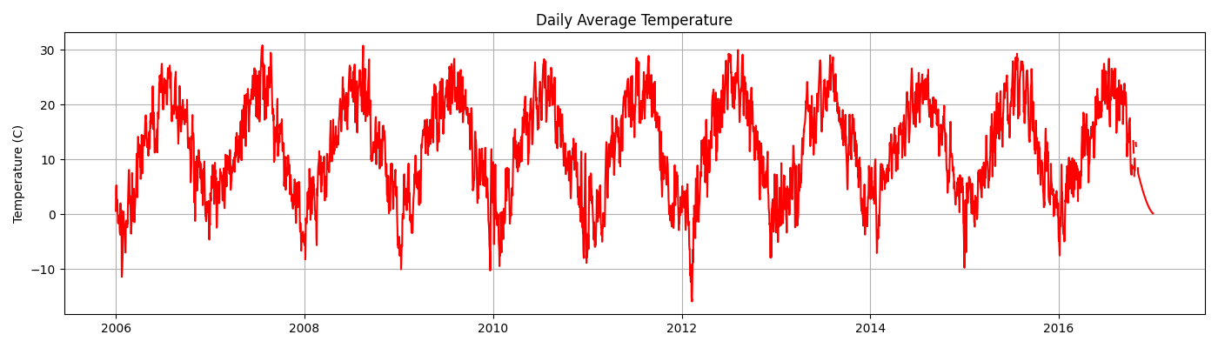
Time Series Trends
Output :

Slide 25
Time Series Trends
Input :
plt.figure(figsize=(14, 4))
plt.plot(monthly_avg.index, monthly_avg.values, marker='o', linestyle='-', color='red')
plt.title('Monthly Average Temperature')
plt.ylabel('Temperature (C)')
plt.grid(True)
plt.tight_layout()
plt.show()
plt.figure(figsize=(14, 4))
plt.plot(yearly_avg.index, yearly_avg.values, marker='o', linestyle='-', color='red')
plt.title('Yearly Average Temperature')
plt.ylabel('Temperature (C)')
plt.grid(True)
plt.tight_layout()
plt.show()

Slide 26
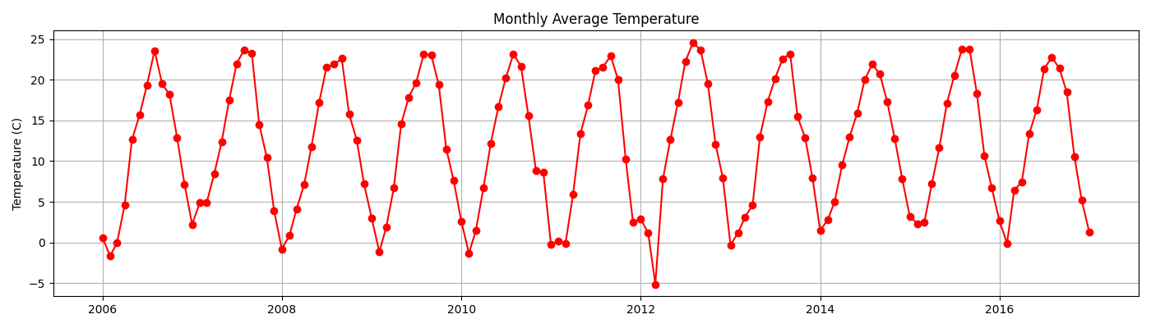
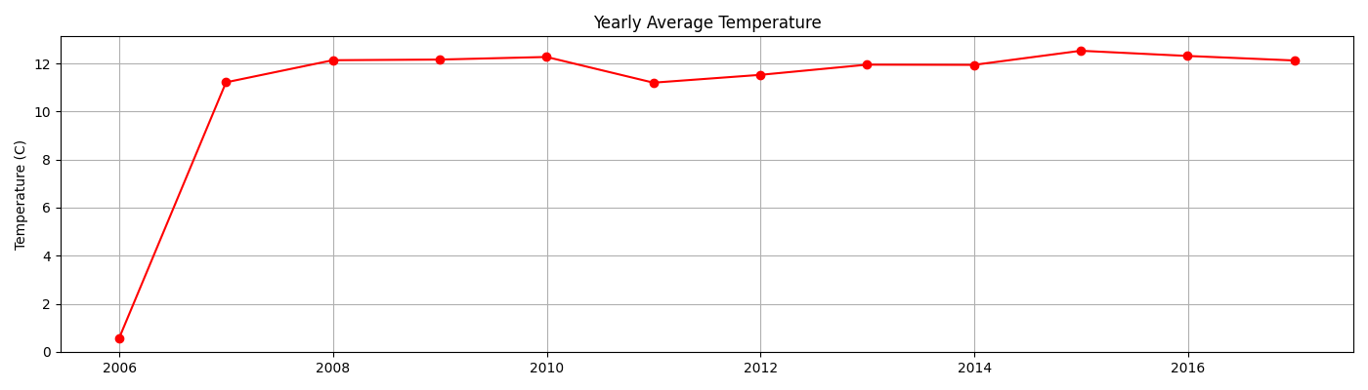
Time Series Trends
Output :

Slide 27
Time Series Trends
Input :
pressure_daily = df['Pressure (millibars)'].resample('D').mean()
pressure_monthly = df['Pressure (millibars)'].resample('ME').mean()
pressure_yearly = df['Pressure (millibars)'].resample('YE').mean()
plt.figure(figsize=(14, 4))
plt.plot(pressure_daily.index, pressure_daily, color='mediumslateblue')
plt.title('Daily Average Pressure')
plt.ylabel('Pressure (millibars)')
plt.grid(True)
plt.tight_layout()
plt.show()

Slide 28
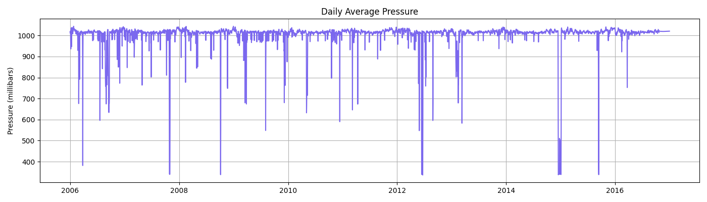
Time Series Trends
Output :

Slide 29
Time Series Trends
Input :
plt.figure(figsize=(14, 4))
plt.plot(pressure_monthly.index, pressure_monthly, marker='o', color='mediumslateblue')
plt.title('Monthly Average Pressure')
plt.ylabel('Pressure (millibars)')
plt.grid(True)
plt.tight_layout()
plt.show()
plt.figure(figsize=(14, 4))
plt.plot(pressure_yearly.index, pressure_yearly, marker='o', linestyle='-', color='mediumslateblue')
plt.title('Yearly Average Pressure')
plt.ylabel('Pressure (millibars)')
plt.grid(True)
plt.tight_layout()
plt.show()

Slide 30
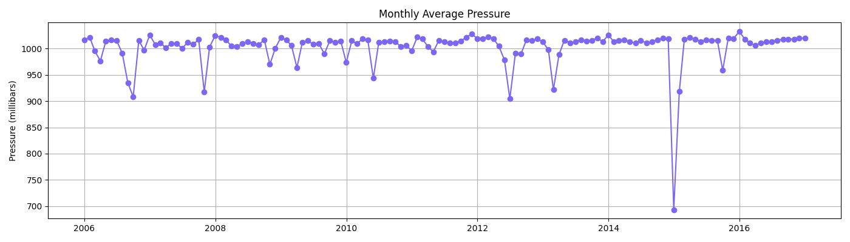
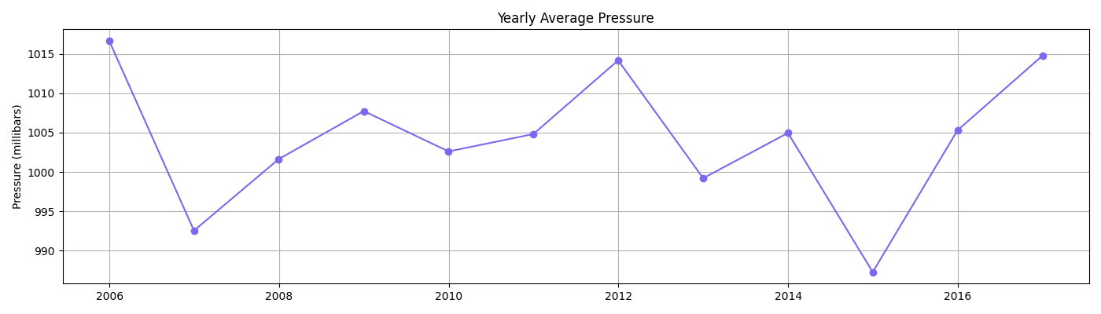
Time Series Trends
Output :

Slide 31
Time Series Trends
Input :
windbearing_daily = df['Wind Bearing (degrees)'].resample('D').mean()
windbearing_monthly = df['Wind Bearing (degrees)'].resample('ME').mean()
windbearing_yearly = df['Wind Bearing (degrees)'].resample('YE').mean()
plt.figure(figsize=(14, 4))
plt.plot(windbearing_daily.index, windbearing_daily, color='teal')
plt.title('Daily Average Wind Bearing')
plt.ylabel('Degrees')
plt.grid(True)
plt.tight_layout()
plt.show()

Slide 32
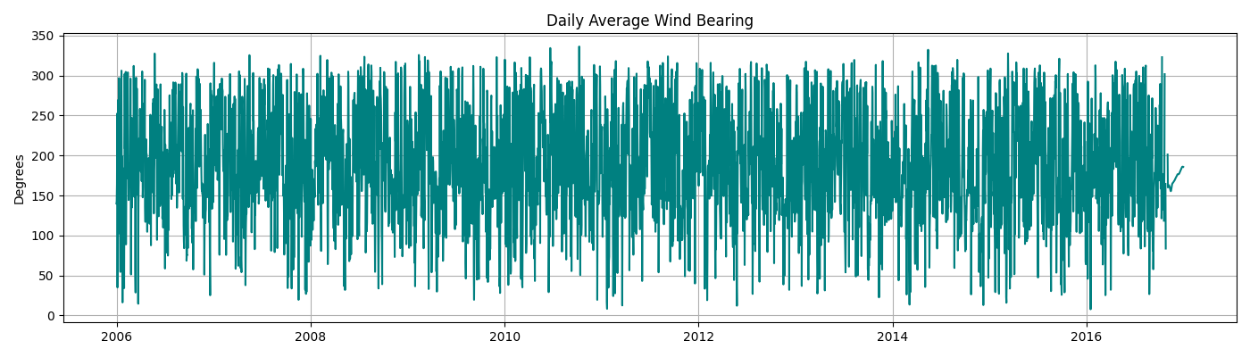
Time Series Trends
Output :

Slide 33
Time Series Trends
Input :
plt.figure(figsize=(14, 4))
plt.plot(windbearing_monthly.index, windbearing_monthly, marker='o', color='teal')
plt.title('Monthly Average Wind Bearing')
plt.ylabel('Degrees')
plt.grid(True)
plt.tight_layout()
plt.show()
plt.figure(figsize=(14, 4))
plt.plot(windbearing_yearly.index, windbearing_yearly, marker='o', linestyle='-', color='teal')
plt.title('Yearly Average Wind Bearing')
plt.ylabel('Degrees')
plt.grid(True)
plt.tight_layout()
plt.show()

Slide 34
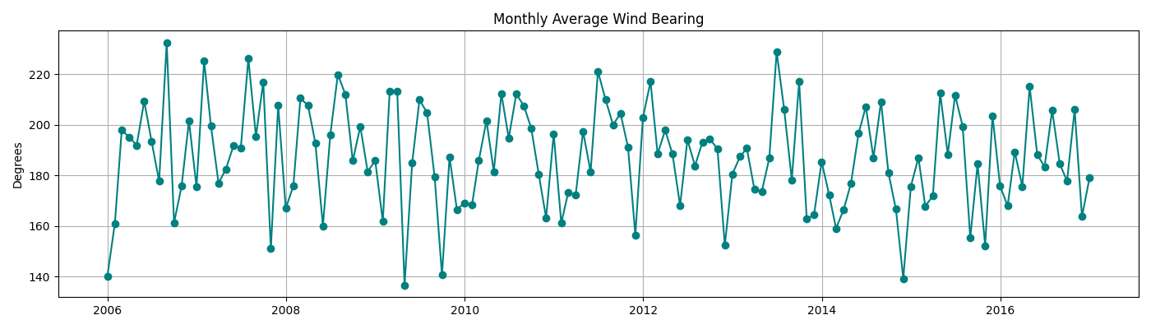
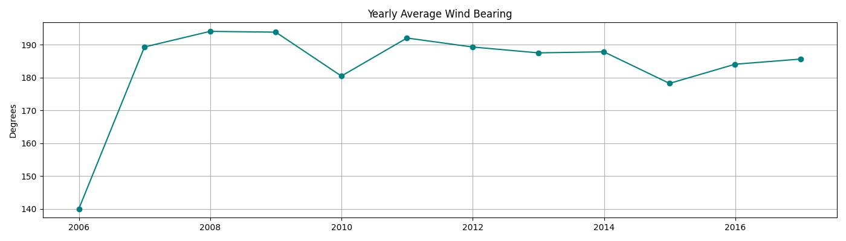
Time Series Trends
Output :

Slide 35
Time Series Trends
Input :
yearly_visibility = df['Visibility (km)'].resample('YE').mean()
plt.figure(figsize=(14, 4))
plt.plot(yearly_visibility.index, yearly_visibility.values, marker='o', linestyle='-', color='mediumslateblue')
plt.title('Yearly Average Visibility')
plt.ylabel('Visibility (km)')
plt.grid(True)
plt.tight_layout()
plt.show()

Slide 36
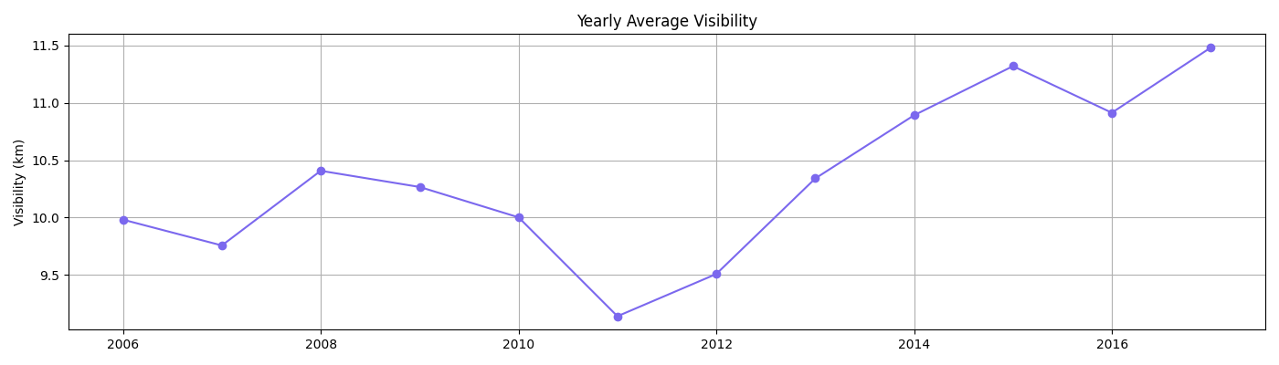
Time Series Trends
Output :

Slide 37
Bivariate Analysis
Input :
daily_avg = df[['Humidity', 'Wind Speed (km/h)']].resample('D').mean()
monthly_avg = df[['Humidity', 'Wind Speed (km/h)']].resample('ME').mean()
yearly_avg = df[['Humidity', 'Wind Speed (km/h)']].resample('YE').mean()
plt.figure(figsize=(12, 4))
plt.plot(daily_avg.index, daily_avg['Humidity'], label='Humidity', color='darkblue')
plt.plot(daily_avg.index, daily_avg['Wind Speed (km/h)'], label='Wind Speed', color='forestgreen')
plt.title('Daily Humidity and Wind Speed')
plt.ylabel('Values')
plt.legend()
plt.grid(True)
plt.tight_layout()
plt.show()

Slide 38
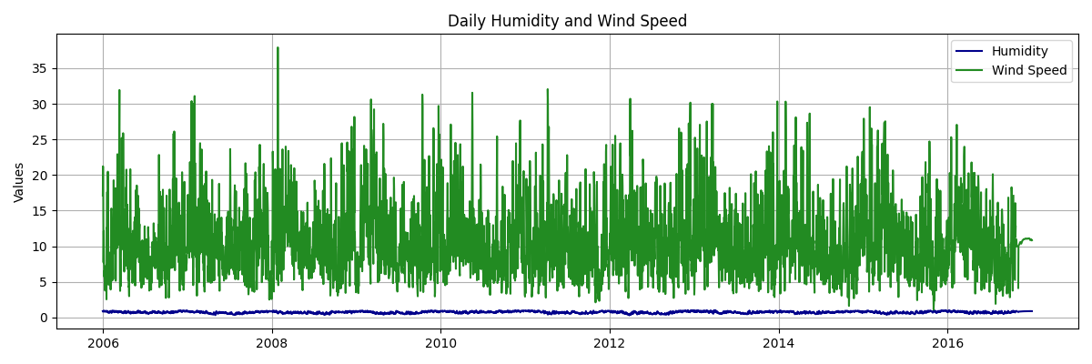
Bivariate Analysis
Output :

Slide 39
Bivariate Analysis
Input :
plt.figure(figsize=(14, 4))
plt.plot(monthly_avg.index, monthly_avg['Humidity'], marker='o', color='darkblue', label='Humidity')
plt.plot(monthly_avg.index, monthly_avg['Wind Speed (km/h)'], marker='o', color='forestgreen', label='Wind Speed')
plt.title('Monthly Average Humidity and Wind Speed')
plt.ylabel('Values')
plt.grid(True)
plt.legend()
plt.tight_layout()
plt.show()
plt.figure(figsize=(14, 4))
plt.plot(yearly_avg.index, yearly_avg['Humidity'], marker='o', color='darkblue', label='Humidity')
plt.plot(yearly_avg.index, yearly_avg['Wind Speed (km/h)'], marker='o', color='forestgreen', label='Wind Speed')
plt.title('Yearly Average Humidity and Wind Speed')
plt.ylabel('Values')
plt.grid(True)
plt.legend()
plt.tight_layout()
plt.show()

Slide 40
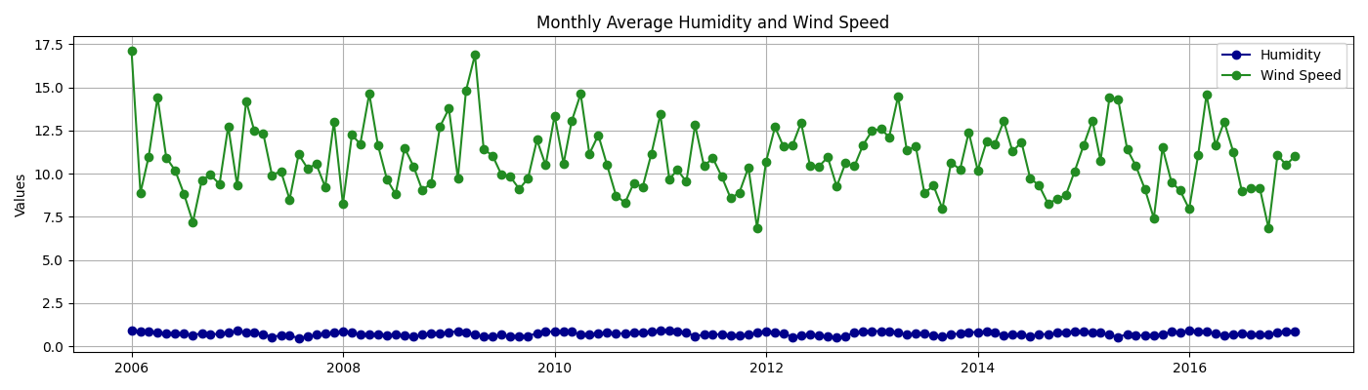
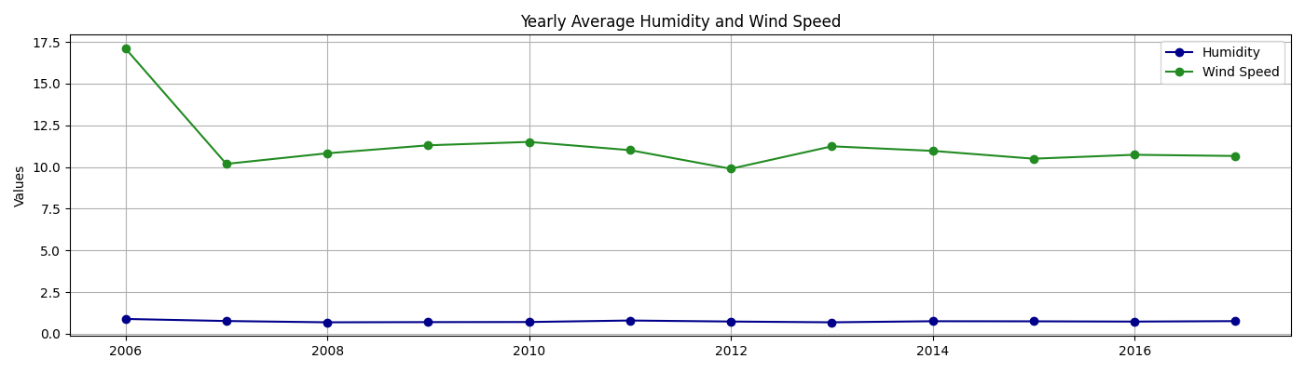
Bivariate Analysis
Output :

Slide 41
Key Questions to Explore
Input :
hottest = df.loc[df['Temperature (C)'].idxmax()]
coldest = df.loc[df['Temperature (C)'].idxmin()]
corr_temp_hum = df['Temperature (C)'].corr(df['Humidity'])
rainy_days = df[df['Precip Type'] == 'rain']
non_rainy_days = df[df['Precip Type'] != 'rain']
hottest = df.loc[df['Temperature (C)'].idxmax()]
if isinstance(hottest, pd.DataFrame):
hottest = hottest.iloc[0]
coldest = df.loc[df['Temperature (C)'].idxmin()]
if isinstance(coldest, pd.DataFrame):
coldest = coldest.iloc[0]

Slide 42
Key Questions to Explore
Input :
print("\n--- Weather Insights ---")
print("Hottest Day:", hottest['Formatted Date'].strftime('%Y-%m-%d'), f"| {hottest['Temperature (C)']:.2f} °C")
print("Coldest Day:", coldest['Formatted Date'].strftime('%Y-%m-%d'), f"| {coldest['Temperature (C)']:.2f} °C")
print("Temp–Humidity Correlation:", f"{corr_temp_hum:.2f}")
print("Avg Temp on Rainy Days:", f"{rainy_days['Temperature (C)'].mean():.2f} °C")
print("Avg Temp on Dry Days:", f"{non_rainy_days['Temperature (C)'].mean():.2f} °C")
print("\n--- Additional Weather Stats ---")
print(f"Average Visibility: {df['Visibility (km)'].mean():.2f} km")

Slide 43
Key Questions to Explore
Input :
print(f"Average Wind Speed: {df['Wind Speed (km/h)'].mean():.2f} km/h")
print(f"Average Wind Bearing: {df['Wind Bearing (degrees)'].mean():.2f}°")
print(f"Average Pressure: {df['Pressure (millibars)'].mean():.2f} millibars")
print(f"Average Humidity: {df['Humidity'].mean():.2f}")
print("\nAverage Wind Speed by Precipitation Type:")
print(df.groupby('Precip Type')['Wind Speed (km/h)'].mean())
print("\nAverage Visibility by Precipitation Type:")
print(df.groupby('Precip Type')['Visibility (km)'].mean())

Slide 44
Key Questions to Explore
Output :
--- Weather Insights ---
Hottest Day: 2007-07-22 | 22.88 °C
Coldest Day: 2012-02-10 | -15.50 °C
Temp–Humidity Correlation: -0.63
Avg Temp on Rainy Days: 13.85 °C
Avg Temp on Dry Days: -3.27 °C
--- Additional Weather Stats ---
Average Visibility: 10.36 km
Average Wind Speed: 10.80 km/h
Average Wind Bearing: 187.52°
Average Pressure: 1003.15 millibars
Average Humidity: 0.73

Slide 45
Key Questions to Explore
Output :
Average Wind Speed by Precipitation Type:
Precip Type
rain 10.971219
snow 9.481998
Name: Wind Speed (km/h), dtype: float64
Average Visibility by Precipitation Type:
Precip Type
rain 10.830711
snow 6.636570
Name: Visibility (km), dtype: float64

